Slide 1
GHF Hackathon-1
Presentation By
Aman Patkar
IIT Jammu

Slide 2
Problem Statement
An organization wants to predict who possible defaulters are for the consumer loans product. They have data about historic customer behavior based on what they have observed. Hence when they acquire new customers they want to predict who is more risky and who is not.
Evaluation Criteria:- roc_auc_score

Slide 3
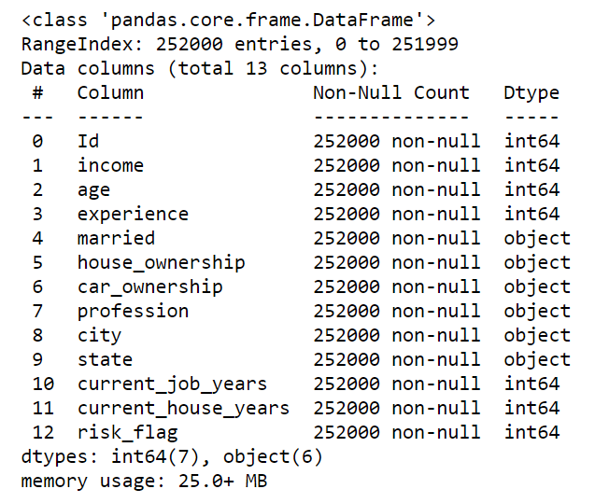
Dataset-Info

Slide 4
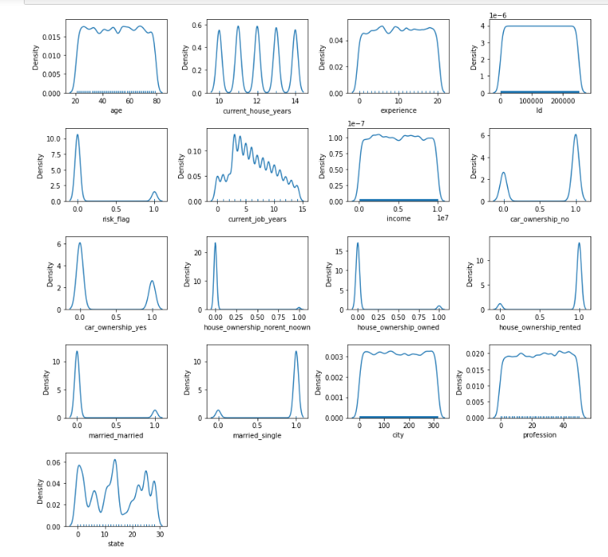
EDA
Distribution of data (Kde plot)
Feature Distribution (kde Plot)

Slide 5
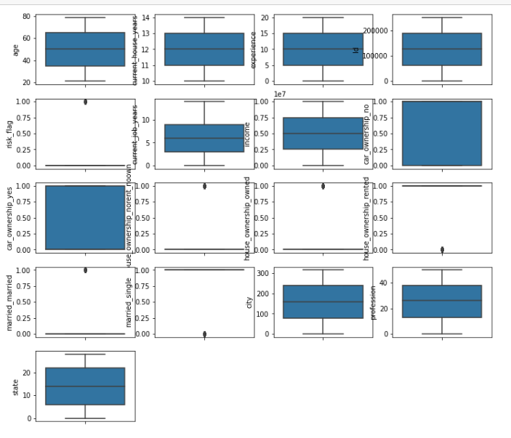
Cont..
Univariate Analysis (Box Plot)

Slide 6
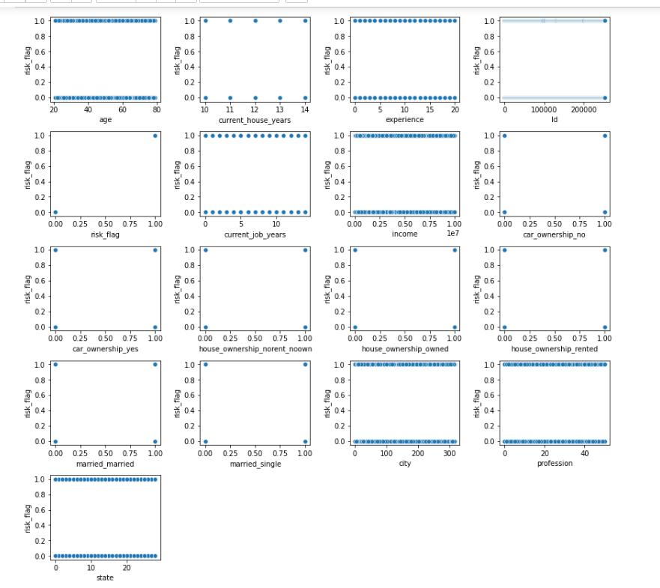
Cont...
Bivariate Analysis (Scatter Plot)

Slide 7
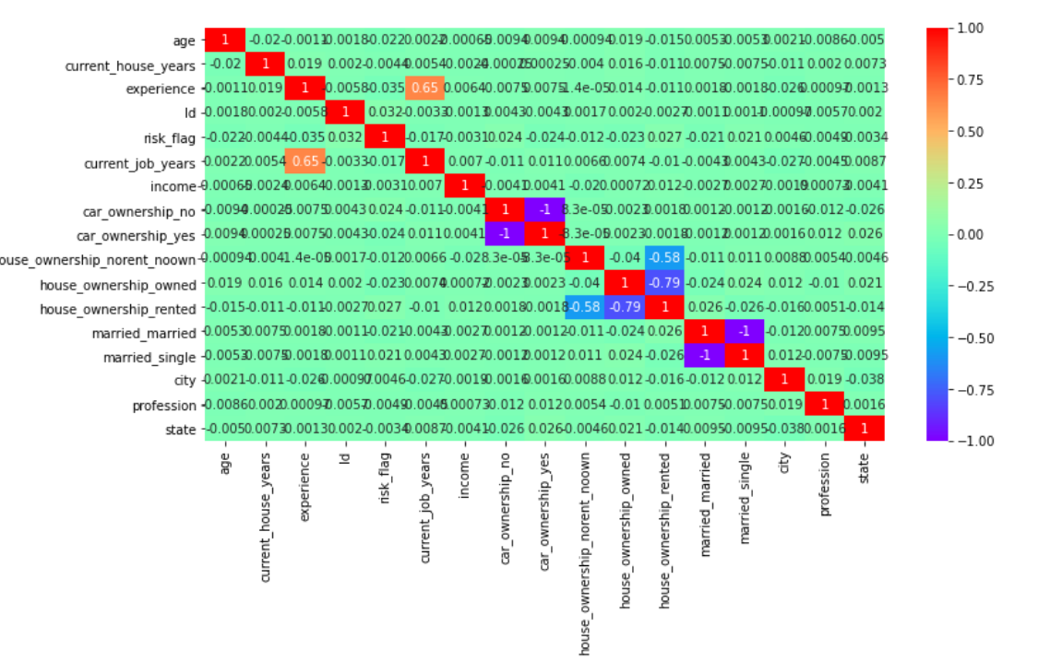
Cont..
Pearson
Correlation
Heat Map

Slide 8
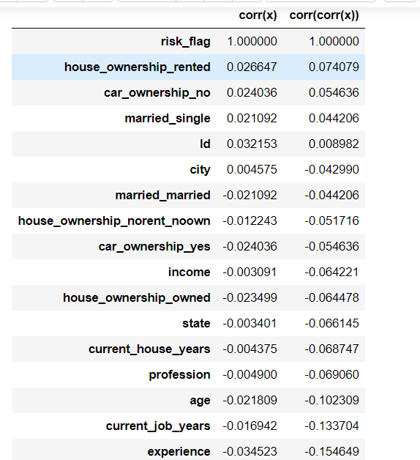
Cont...

Slide 9
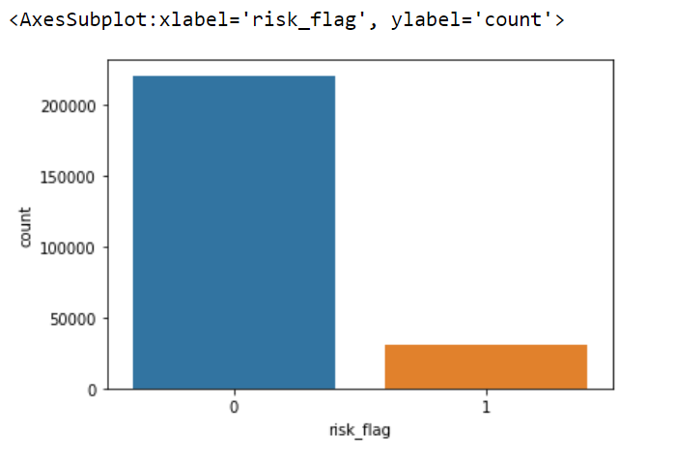
Balance of Data

Slide 10
Conclusion from EDA
From the Univariate analysis we can see the distribution of variables and median of the variables clearly.
From the correlation heat map and table, we can say that ‘experience’ and ‘current_job_year’ are highly correlated, etc. It can be think of feature combination. (I tried it but it doesn’t improve the model)
Of Course from the count plot, it is clearly visible that data is imbalance and it needs special care while modelling.

Slide 11
Model Building
I tried following models while handling imbalanced dataset.
RandomForestClassifier
GradientBoostingClassifier
ExtraTreesClassifier
XGBClassifier
Catboost (Final_Selected)
Tried average probability obtained by different algorithms

Slide 12
What did i try for imbalance dataset
I tried UnderSampling, OverSampling, SmoteTomek, TomekLinks, SmoteENN, Condensed Nearest Neighbour, Edited Nearest Neighbour.
I also used class_weights hyperparameter to take care of imbalance dataset.

Slide 13
Why did i Select Catboost Algorithm
I tried almost every popular algorithm while taking care of imbalance dataset, i got good results while doing undersampling and training over Extra tree classifier but it was not enough for the hackathon. So i explore more and use Catboost algorithm, which gave me the highest roc_auc_score over my training data and the threshold was also not that low so that it cause me the problem of overfitting of 40% dataset of public leaderboard.

Slide 14
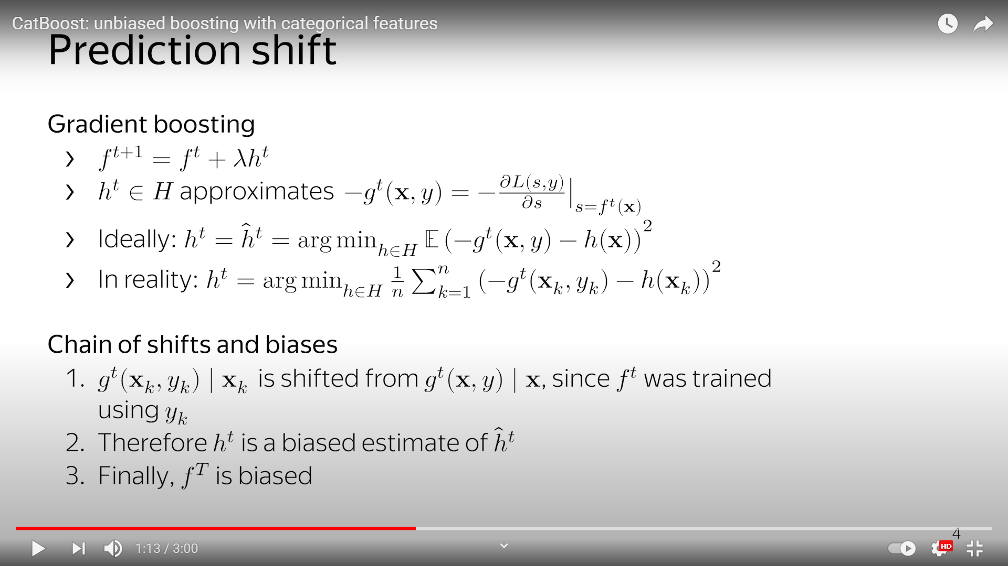
Modification in Catboost while boosting

Slide 15
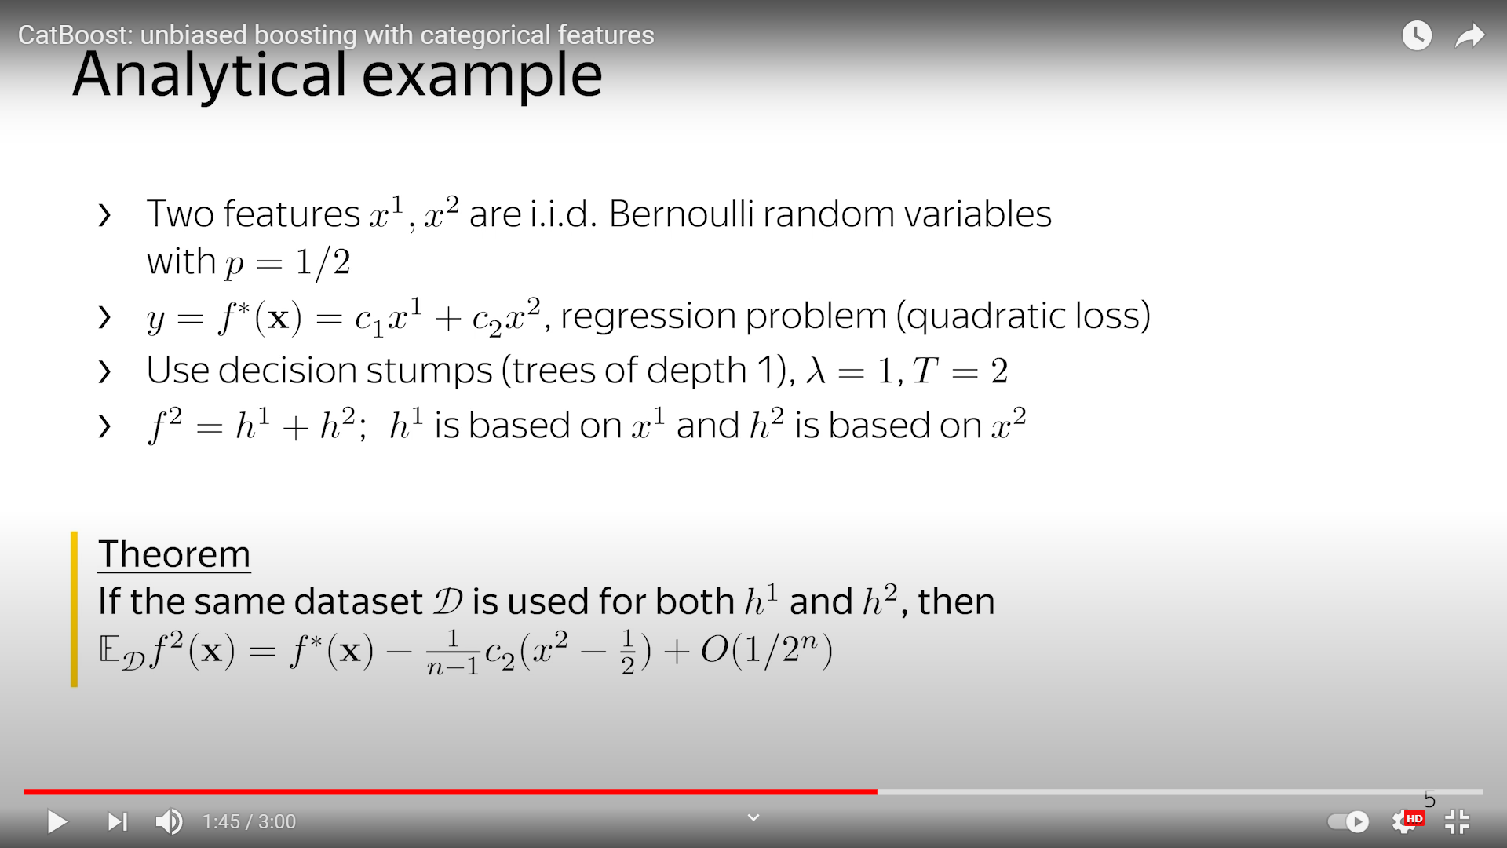
Cont...

Slide 16
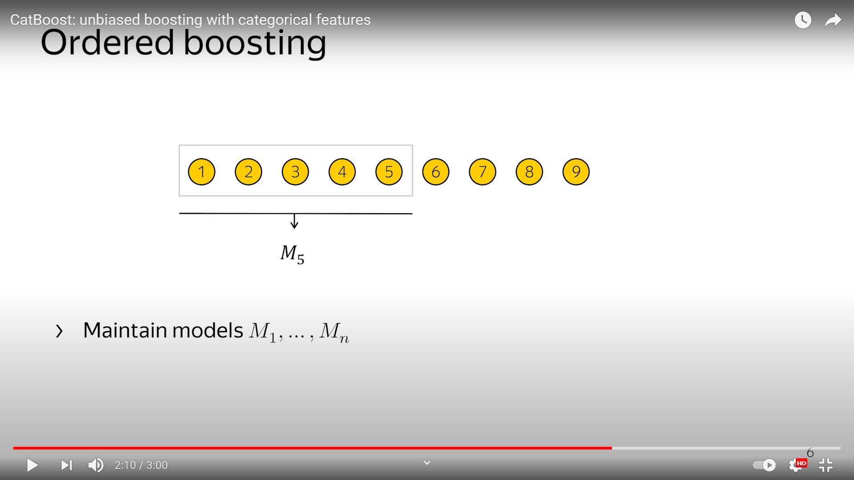
Cont...

Slide 17
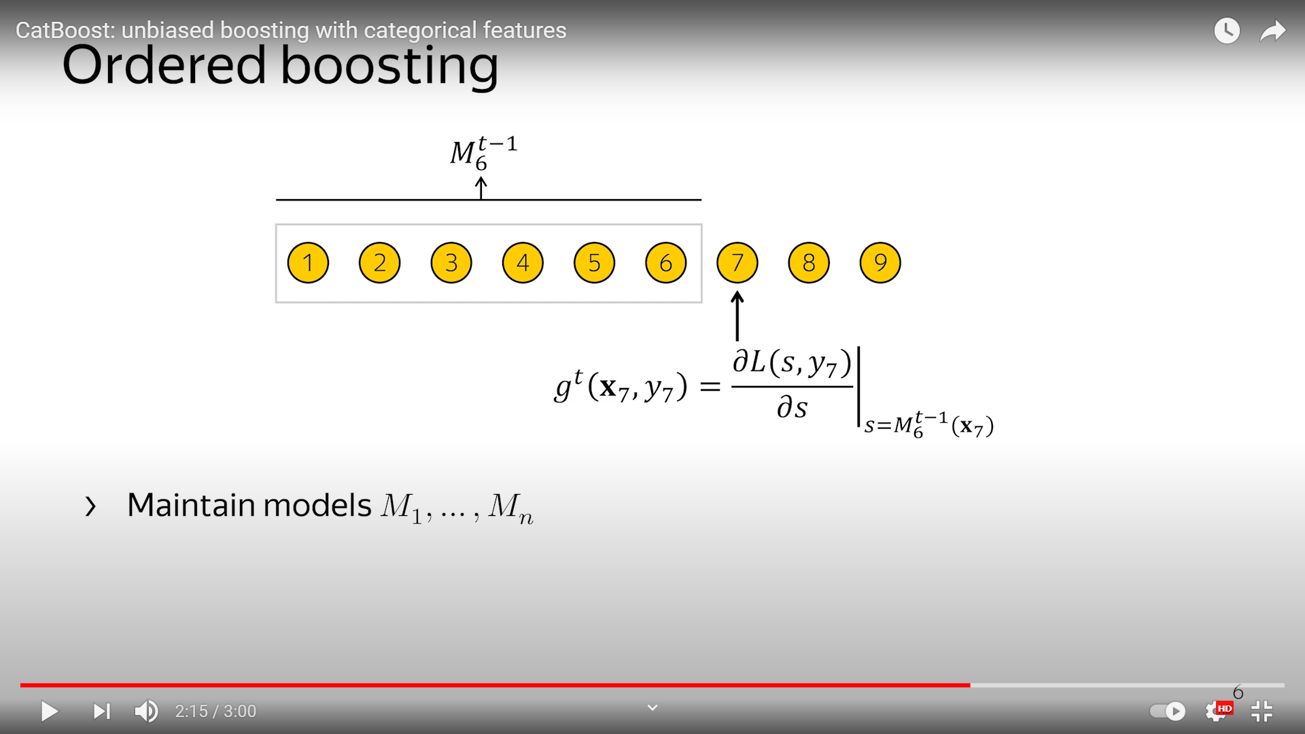
Cont...

Slide 18
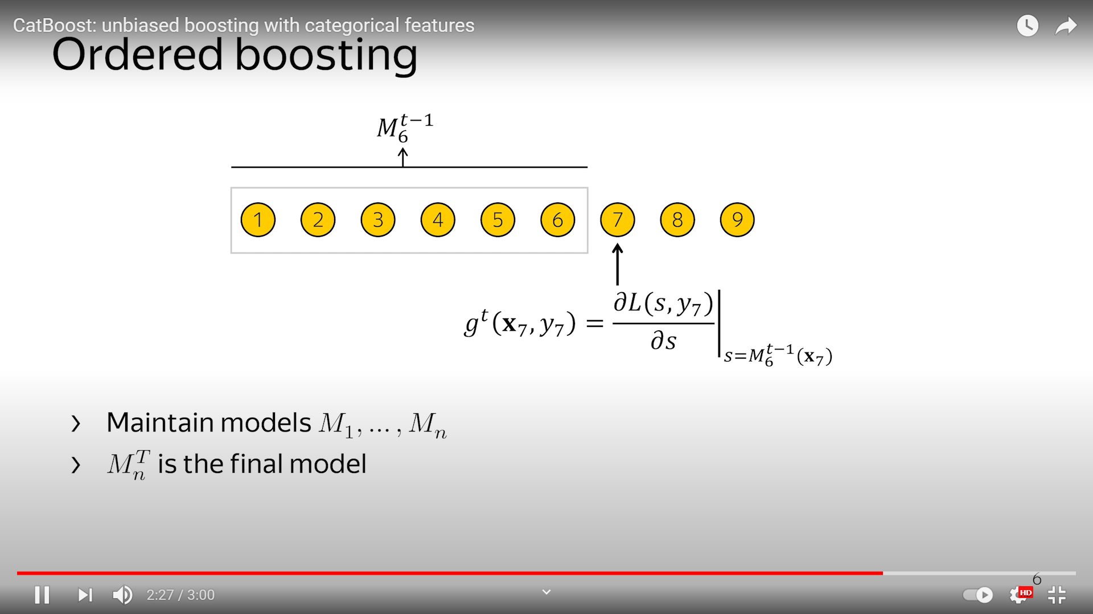
Cont...

Slide 19
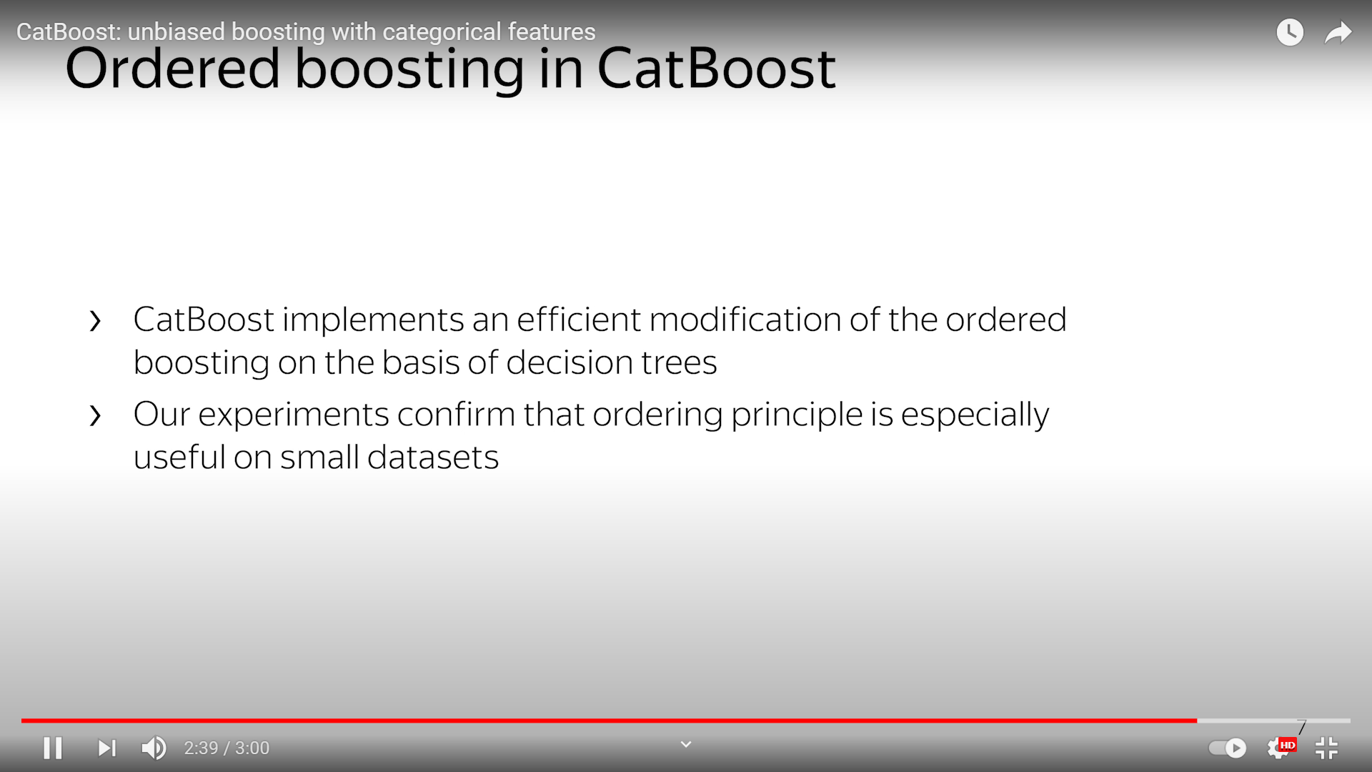
Cont...

Slide 20
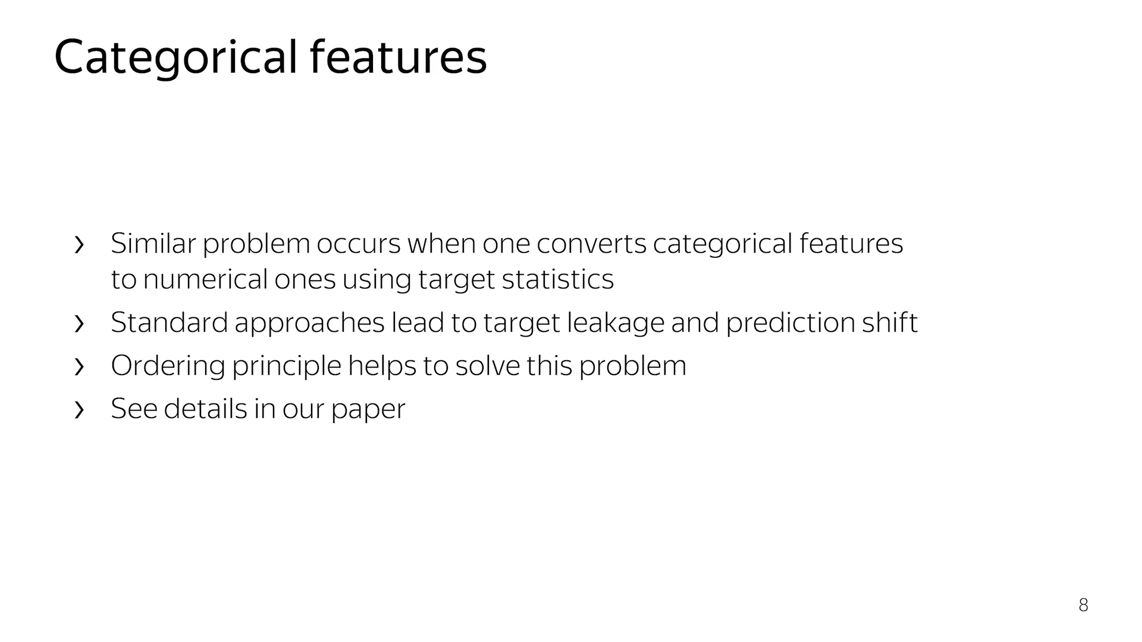
Cont...

Slide 21
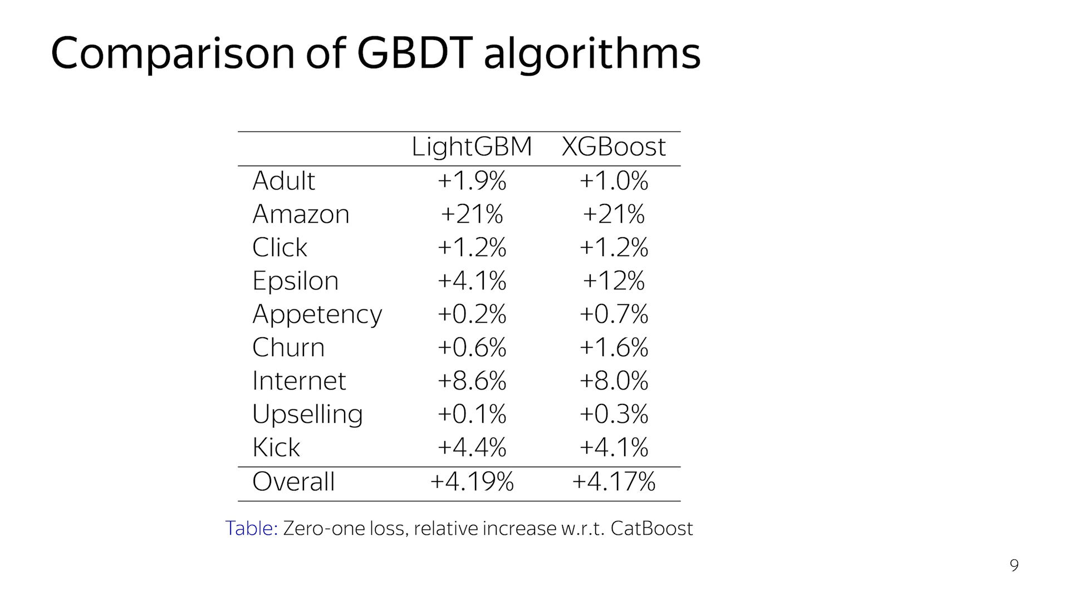
Cont...

Slide 22
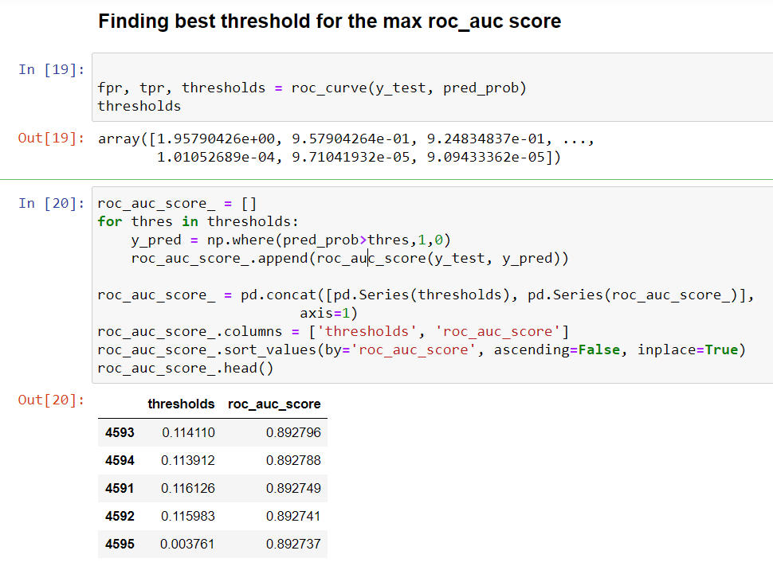
How did i Choose optimal threshold for maximum roc_auc_score

Slide 23
References
https://arxiv.org/abs/1706.09516
https://www.youtube.com/watch?v=jLU6kNRiZ5o

Slide 24


Thanks!
Contact No:- 8082350880

